Slide 1
Medium/Heavy Duty
Truck Engines, Fuel & Computerized Management Systems, 3E
Chapter 7
Diesel Engine Power Train Assemblies
Copyright © 2009 Delmar, Cengage Learning

Slide 2
Introduction
The internal works on an engine include a grouping of parts responsible for transmitting the gas pressures developed in the cylinders to a power take off mechanism
This mechanism is usually the engine’s flywheel
Copyright © 2009 Delmar, Cengage Learning

Slide 3
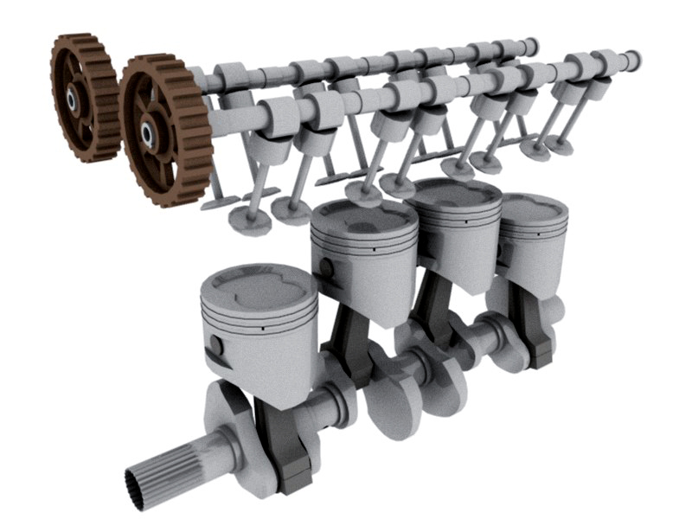
Power Flow Components
Pistons
Piston Rings
Wrist Pins
Connecting Rods
Crankshaft
Friction Bearings
Copyright © 2009 Delmar, Cengage Learning

Slide 4
Power Flow Components
Cylinder Pressure
Piston
Connecting Rod
Crankshaft
Power out
Copyright © 2009 Delmar, Cengage Learning

Slide 5


Piston Assemblies
The Piston
  A circular plug
  Seals the cylinder bore
  Reciprocates within the bore
The Piston Assembly Includes:
  Piston
  Piston Rings
  Wrist Pin
Subject to the gas pressure conditions within the cylinder
Imparts force on the compression stroke
Receives force on the powerstroke
Connects the piston to the connecting rod
Copyright © 2009 Delmar, Cengage Learning

Slide 6
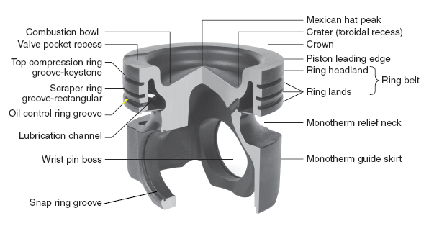
General Piston Terminology
A typical forged steel trunk piston used on many current diesel engines
Copyright © 2009 Delmar, Cengage Learning

Slide 7
Piston Design
Valve Pockets
With a “Low Clearance Volume” design, the piston rises in the bore to a height that requires recesses to accommodate the valve head protrusion
“Mexican Hat” crown design common in low emission DI engines!
Piston Crown
  Direct exposure to combustion chamber
  Geometry controls gas dynamics
  Designed with low clearance volume
  Pistons absorbs up to 20% of rejected heat of cylinder gases
  Essential ability:
    Rapidly dissipate heat
Copyright © 2009 Delmar, Cengage Learning

Slide 8
Piston Design Terminology
Piston Style
Trunk
Aluminum
Forged Steel
Composite Steel
Articulating
Cam Ground
Separate Skirt
Crosshead
Full Articulating
Copyright © 2009 Delmar, Cengage Learning

Slide 9
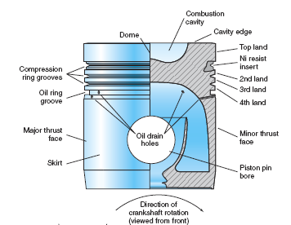
Trunk Style Pistons
The advantage of the aluminum’s low weight was offset by a lack of metallurgic “toughness”.
Alloying and surface treatments were introduced as solutions
Aluminum Alloy
  Low weight
  Toughening treatments:
    Hypereutectic process
      Silicone
    Anodizing
    Plating
    Heat treating
    Fiber reinforcing
      Ceramic (CFA)
      Squeeze cast (SCFR)
  Ring groove insert used
  Cam ground
Commonly used in most commercial diesel engines until the 1990’s
Advantages:
Lighter piston weight
  Less mass and inertia forces against the connecting rods and crankshaft.
  Allows the use of lighter components
Cooler piston crown temperatures
Quieter engine operation. Less combustion related noise compared to articulating pistons
With aluminum’s high coefficient of heat expansion, diesel pistons are “cam ground” to be slightly elliptical when cold. At the piston heats, the piston material expands to a circular shape
Warning!!
Subjecting a diesel engine (with
cam ground pistons) to high cylinder pressures before the engine is at operating temperatures can over-stress the piston rings and ring lands!
Usually a Ni-ResistTM insert for resistance to high temperatures. This product has an identical coefficient of heat expansion to that of aluminum
Copyright © 2009 Delmar, Cengage Learning

Slide 10
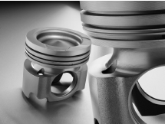
Trunk Style Pistons
2004
2007
2010
Forged Steel
  First introduced in drag racing applications
  Introduced to diesel engine service in 2002
  Currently used by many OEM’s to meet emission standards
  Design adopted by diesel engine OEM’s originated with piston design specialist Mahle
  The skirt is designed to guide
    the piston over the thrust sides
    and is recessed across the pin
    boss transverse
Designed for cylinder pressures
exceeding 3500 psi (250 bar)
Cummins ISX
Advantages of the Mahle Forge Steel Piston
Piston “slap” overcome with the MonothermTM design.
  Since the steel expands at a lesser rate than aluminum, tolerances to the cylinder bore are much tighter.
The alloyed strength of the construction allows less material to be used resulting in a piston weight comparable to aluminum.
The wrist pin bore is phosphate treated, eliminating the need for bushings
The MonothermTM
A MAHLE designed piston
Note:
Large circumferential slot between the pin boss and ring belt
Copyright © 2009 Delmar, Cengage Learning

Slide 11
Advantages of Forged Steel Trunk Pistons
Increased cylinder combustion pressures
  Reduction of “Headland Volume”
    Material strength allows the top ring to be placed closer to the crown leading edge
Engine longevity concerns
  More favorable thermal expansion factors
    Less vulnerability of piston damage by high cylinder pressures during cold start-up
    Phosphate coatings provide longer service life than aluminum counterparts
Lighter weight
Emissions
Copyright © 2009 Delmar, Cengage Learning

Slide 12
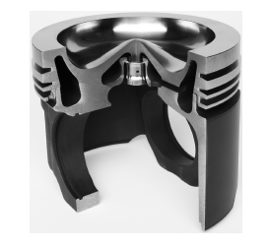
Composite Steel Trunk Pistons
In the process of being introduced to the industry
Variation of forged steel trunk style piston
Mahle version will be know as MonocompTM
Crown
Manufactured from high temperature steel
Trunk
Steel skirt manufactured separately. Components joined together to create assembly
Copyright © 2009 Delmar, Cengage Learning

Slide 13
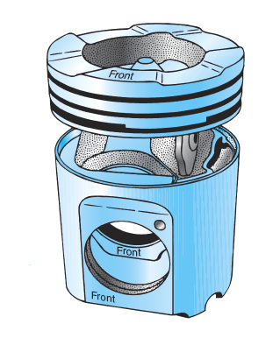
Articulating Pistons
Adopted by most diesel engine OEM’s during the 1990’s
Usage recently dropped off in favor of forged steel and composite steel trunk type pistons
Two styles
  Crosshead – semi floating wrist pin
  Full articulating – full floating wrist pin
Favored by Detroit Diesel for many years
A Mack Truck three ring articulating piston used in the “E-Tech” engines.
The crown has been raised slightly to illustrate the separate components
Copyright © 2009 Delmar, Cengage Learning

Slide 14
Articulating Pistons
Advantages
  The crown is either forged steel or cast iron:
    More suitable for high cylinder pressures
    Sustains higher cylinder temperatures
    Allows for reduced headland volume essential for reducing emissions and improving fuel economy
    Greater longevity compared to aluminum trunk style
  The skirt may be made from a lighter material
  Reduced piston slap
Disadvantages
  Weight and tensional loading on the powertrain
    Requires “beefed up” block and powertrain components
Copyright © 2009 Delmar, Cengage Learning

Slide 15
Combustion Chamber Designs
Direct Injection (DI)
  Piston crown shape determines gas dynamics
High Turbulence Design
  Injector positioned directly over piston crown
  Aggressive crown geometry = aggressive cylinder turbulence
  Larger injected fuel droplets require aggressive turbulence
    Turbulence “rips” droplets into smaller droplets
  Modern designs & higher injection pressures reduced need for the “high turbulence” design
  Multi pulse fuel injection has seen a revisiting of the high turbulence design.
High turbulence design may disadvantage emissions by “throwing” fuel outside of primary flame front causing late ignition and unwanted afterburn!
Copyright © 2009 Delmar, Cengage Learning

Slide 16

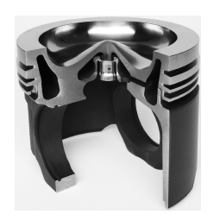
Combustion Chamber Designs
Mexican Hat Piston Crown
  Most common design
  Central piston area recessed
    “Toroidal recess”
  Aggressiveness of central cone designed to produce desired turbulence
  Injector positioned directly above center
  Directs fuel towards crater where air swirl is greatest
With this design, fuel droplets can be directed into the crater and will ignite before touching the crown material.
This prevents fuel burnout scorching of the piston directly below the injector, lengthening service life
  Deep bowl designs produce greater turbulence
  “Quiescent” designs use low turbulence & higher injection pressures
Copyright © 2009 Delmar, Cengage Learning

Slide 17
Combustion Chamber Designs
Other Piston Crown Designs
Mann
  Also known as “M” Type
  Designed and named after German originating company
  Features a spherical recess directly under the injector
  Recess not necessarily in center of crown
  Produces high turbulence
  More vulnerable to localized burnout in bowl
Dished
  Used in:
  Some small bore engines
  Some IDI engines
  Slightly concave (almost flat)
  Produces low turbulence
Also known as a bowl
Copyright © 2009 Delmar, Cengage Learning

Slide 18
Piston Heat Management
Combustion temperatures can have transient spikes to 2000º C or 3630º F
  Piston material – role as a “heat siphon”
    Aluminum melts @ 660º C or 1220º F
    Cast Iron melts @ 1540º C or 2800º F
Some heat transferred to the cylinder walls through the piston rings
  Cooling is often assisted with an oil spray to piston’s underside
Heat flow through aluminum is approximately three times greater than cast iron!
Copyright © 2009 Delmar, Cengage Learning

Slide 19
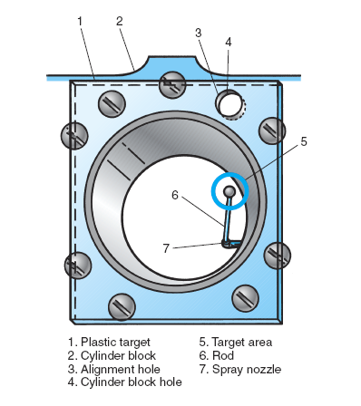
Piston Cooling
Cooling method determination:
  Size of piston
  Peak cylinder pressure
  Aspiration
Some heat is transferred through piston assembly
Methods used to cool piston heads:
  Shaker
  Circulation
  Spray
Caution!
A misaligned spray nozzle can cause premature engine failure !
Some newer engines rely entirely on oil spray to cool and lubricate the piston assembly
Oil is delivered through the connecting rod to galleries under the piston crown.
Oil is distributed by piston motion & returned to the crankcase
Oil is delivered through the connecting rod & wrist pins. Circulated through a series of grooves machined into the underside of the piston crown & returned to the crankcase
A stationary jet mounted to the engine block directs a spray of directly to the underside of the piston. In addition to cooling, the oil may also lubricate the wrist pin. Most current in use.
Copyright © 2009 Delmar, Cengage Learning

Slide 20
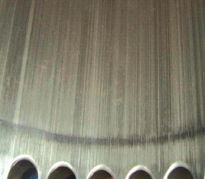
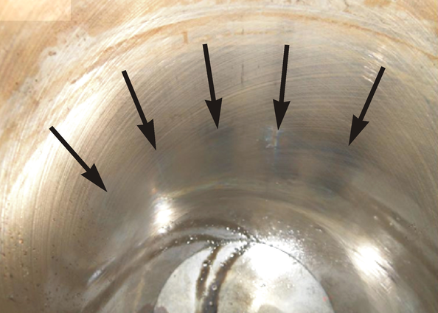
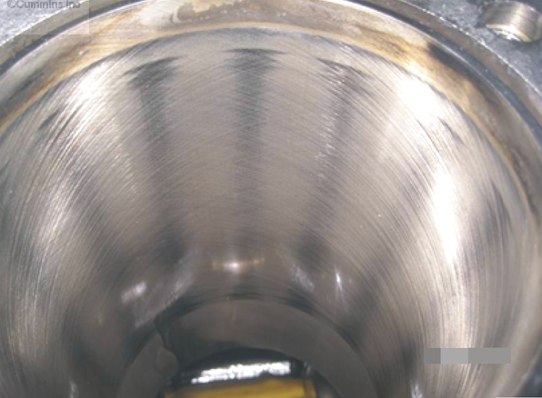
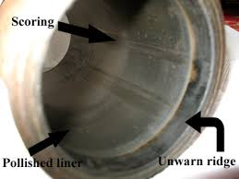
Piston Fit Problems
Excessive Clearance
  Piston knocking
  More noticeable:
    When cold
    With aluminum trunk pistons
Inadequate Clearance
  Piston scoring
  Piston scuffing (localized welding)
    Lubricating oil film scraped from cylinder walls
Copyright © 2009 Delmar, Cengage Learning

Slide 21
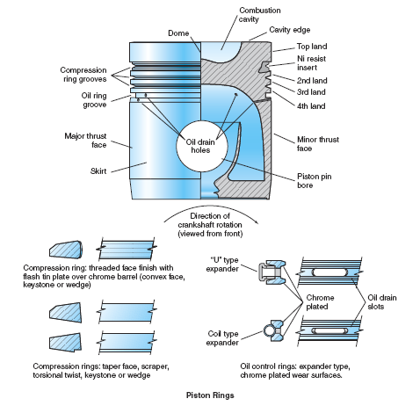
Piston Assembly Overview
Compression Ring Location
Includes “Scraper Ring”
Ring Lands
Compression ring finish & design is critical to establishing cylinder seal
Oil Control Ring Location
Oil Control Rings
Note “channel “ design
The number of rings used is determined by the OEM.
Factors include bore size, engine speed & configuration
Ring drain slots work in conjunction with the piston’s drain holes
Oil drain slots
Copyright © 2009 Delmar, Cengage Learning

Slide 22
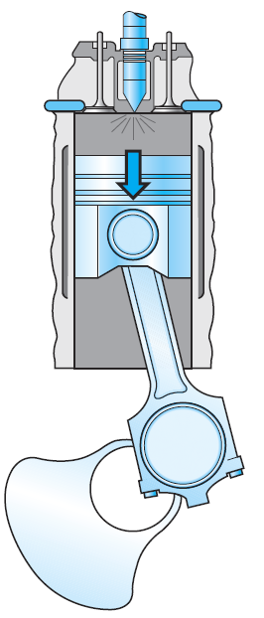
Piston Thrust and Antithrust
Thrust face
Anti Thrust Face

Slide 23
Piston Rings
Function:
Seal piston in bore
  Compression
  Combustion gases
Lubrication
  Apply film of lubricant to cylinder wall
  Regulate amount of film on the cylinder wall
Cooling
  Provide a path to transfer heat from the piston to the cylinder wall
Copyright © 2009 Delmar, Cengage Learning

Slide 24
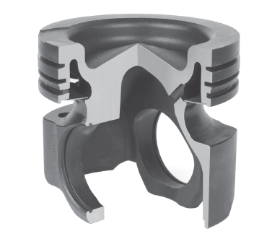
Roles of Piston Rings
Categories
Compression
Seals engine cylinder
Dissipates piston heat
Compression
Copyright © 2009 Delmar, Cengage Learning

Slide 25
Roles of Piston Rings
Categories
Compression
Seals engine cylinder
Dissipates piston heat
Scraper
Seals engine cylinder
Manages oil film on cylinder wall
Scraper
Copyright © 2009 Delmar, Cengage Learning

Slide 26
Roles of Piston Rings
Categories
Compression
Seals engine cylinder
Dissipates piston heat
Scraper
Seals engine cylinder
Manages oil film on cylinder wall
Oil Control
Lubricates cylinder walls
Dissipates piston heat
Oil Control
Copyright © 2009 Delmar, Cengage Learning

Slide 27
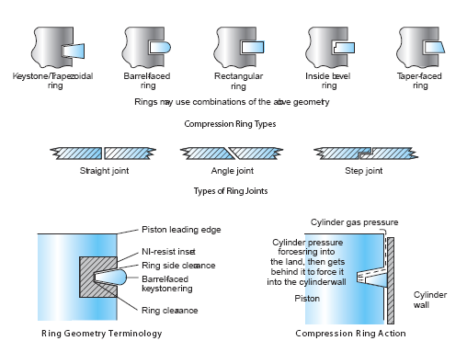
Compression Ring Geometry
Major sealing force -- cylinder gases
Pressure forces ring downward to land
Pressure gets behind ring
Ring is forced outwards by pressure
The higher the cylinder pressure, the tighter the seal!
Primary Function
  Sealing cylinder gases
Face Types
  Keystone/Trapezoidal
  Barrel faced
  Rectangular
  Inside Bevel
  Taper Faced
Joint Types
  Straight
  Angle
  Step
Wedge shaped
Commonly used as top ring
Gas pressure easily gets behind to assist with sealing
The angled outer face achieves higher sealing pressures.
Internal peripheral recess allows cylinder gas to get behind twisting the ring.
This twisting effect results in unusually high sealing pressures
Preferred when ring is made of cast iron due to the even “loading” achieved.
Lower sealing pressures.
Greater longevity.
Used as second or third compression ring in some applications where a keystone style is used in the top position.
Outer surface “barreled” with a radius
Designed to increase service life
No sharp “bite” into the cylinder wall
Many keystone rings are barrel faced.
Defined by the “L” shaped step at the abutting joint.
Affords the least potential for cylinder gas leakage at the joint
Defined by the complimentary angles at the abutting joint.
Provides a fairly efficient seal.
The disadvantage of this style is the greater potential of gas “blow-by.
This is the most commonly used design
Gas that blows by all the rings
enters the crankcase
Crankcase pressures could be an indication of overall engine health.
Copyright © 2009 Delmar, Cengage Learning

Slide 28
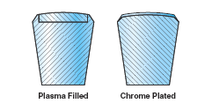
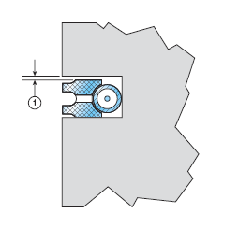
Ring Construction
Modern compression rings are coated
  To reduce friction
  To facilitate “run in”
Combination Compression & Scraper Rings
  If used, located in intermediate area of ring belt
  Designed to assist with cylinder sealing & oil film control
Oil Control Ring
  Manages lubricant film
    Excessive oil will end up in combustion chamber
    Inadequate will result in scoring & scuffing
  Conformable
    Ring flexes to accommodate moderate liner distortions
Some “break-in”
coatings will end up
in the crankcase…remember this when examining oil sample reports!
A circumferential expander (spring) forces the oil control ring into the cylinder walls
The adding & removal
of oil is also the removal
of heat from the cylinder walls
Copyright © 2009 Delmar, Cengage Learning

Slide 29
Ring Construction
Piston & Cylinder Wall Lubrication
  Oil Control Rings
    Precisely manage cylinder oil film
  Piston Downstroke
    Oil is forced into the lower part ring groove
  Piston Upstroke
    Oil accumulated on the downstroke transferred to the upper side of ring land
    Oil is applied to the cylinder
Copyright © 2009 Delmar, Cengage Learning

Slide 30
Compression Ring Construction
Modern compression rings are coated
  To reduce friction
  To facilitate “run in”
Combination Compression & Scraper Rings
  If used, located in intermediate area of ring belt
  Designed to assist with cylinder sealing & oil film control
Oil Control Ring
  Manages lubricant film
    Excessive oil will end up in combustion chamber
    Inadequate will result in scoring & scuffing
  Conformable
    Ring flexes to accommodate moderate liner distortions
Copyright © 2009 Delmar, Cengage Learning

Slide 31
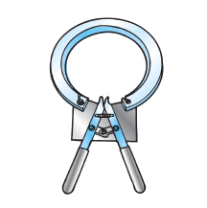
Installing Piston Rings
Trying to stretch a ring by hand may:
Bend or break the ring
Crack the plating or cladding material
The correct tool is a wise investment
Never “over stretch” a ring
Caution!
Always use the correct tool
Never install a cracked or chipped ring
Most rings have an “up side”
  Know how to determine the correct orientation!
Always check ring “end gap”
Always observe OEM instructions
Ring Expander
Copyright © 2009 Delmar, Cengage Learning

Slide 32
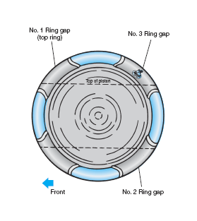
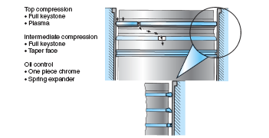
Assembling Pistons & Rings
Ring gap “stagger is”
theoretically determined by
dividing 360º by the number of rings.
Ring gaps should not be placed directly over piston thrust faces
Always reference OEM literature
Ring Stagger
  Always observe OEM protocol
  Check ring side clearance
A typical Mack ring stagger recommendation
International’s recommendation for ring stagger & pressure balance
Copyright © 2009 Delmar, Cengage Learning

Slide 33
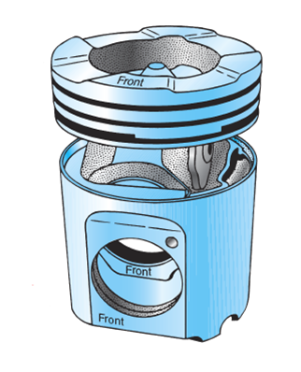
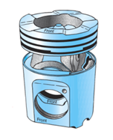
Piston or Wrist Pins
Maximum engine speed
& expected cylinder pressure determines whether the pin will be solid or bored through!
Piston Pins
Function:
Primary – connect the piston to the connecting rod
With an articulating piston, the pin also connects the piston skirt to the piston crown
Power is transferred from the piston crown through the pin to the connecting rod
Copyright © 2009 Delmar, Cengage Learning

Slide 34
Piston or Wrist Pins
Piston Pin
The bearing surfaces of the piston pin are lubricated in one of two ways:
Full floating piston pins are
fitted to both the connecting rod & the piston boss with minimal clearance
Some newer piston bosses are
bushingless!
Copyright © 2009 Delmar, Cengage Learning

Slide 35
Piston or Wrist Pins
Piston Pin
The bearing surfaces of the piston pin are lubricated in one of two ways:
Directly through the connecting rod
The term used to describe the oil passage through the connecting rod is “rifle drilled”
Copyright © 2009 Delmar, Cengage Learning

Slide 36
Piston or Wrist Pins
Piston Pin
The bearing surfaces of the piston pin are lubricated in one of two ways:
Directly through the connecting rod
By the piston cooling jet spray
Copyright © 2009 Delmar, Cengage Learning

Slide 37
Piston or Wrist Pins
All full floating piston pins need a method to secure them
Piston Pin Retention
Piston Pin Retention
Snap rings
Plugs
Used by most OEM’s
Always observe the installation instructions!
Snap rings are subject to inertia
Failure to follow directions may result in engine failure
All plug style retainers must be checked for seal integrity after installation.
Failure to do so may result in excessive oil being added to the cylinder walls
Copyright © 2009 Delmar, Cengage Learning

Slide 38
Reusing Piston Assemblies
Reuse of pistons:
  Not a common practice with aluminum trunk style pistons
  More common with forged steel crown pistons
  Always observe OEM recommended practices
  Routine replacement may not be justified
  If performing engine work under warranty, determine if piston replacement is covered beforehand
Copyright © 2009 Delmar, Cengage Learning

Slide 39
Reusing Piston Assemblies
Clean all crystallized carbon out of the ring grooves
    Use a correctly sized ring groove cleaner
Visually assess the condition of the ring groove
Measure the cleaned ring groove with a new ring installed square in the groove
Before installing the new rings on the piston, check the ring gap by installing the ring squarely into the cylinder and measuring with a thickness gauge
Always follow OEM specifications!
Always measure all new rings before installation!
A broken compression
ring can be ground
square and used successfully
Copyright © 2009 Delmar, Cengage Learning

Slide 40
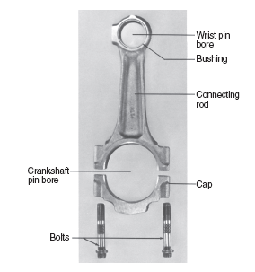
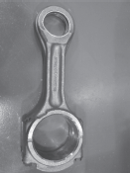
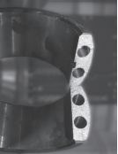
Connecting Rods
Transmits the force from the piston to the crankshaft
Ends have bearing surfaces
  This allows the linear force to be converted to rotary action by the crank throw rotating around the crank’s centerline
After machining, the rod is fractured
The rough surfaces provide a perfect final fit alignment eliminating the need to check rod side play
Most truck & bus diesel engines use two piece rods
These are forged in one piece, severed and machined after “bolted” reassembly
Some OEMs use “cracked” or fractured rod technology
Copyright © 2009 Delmar, Cengage Learning

Slide 41
Compressional Loading
Connecting rod is compressionally loaded:
  On the power stroke
  On the compression stroke
Very seldom is compressional loading a major contributing factor to rod failure
Increased compressional loading due to hydraulic lock may result in connecting rod failure
“squeezed”:
For example: coolant leakage into the cylinder
Copyright © 2009 Delmar, Cengage Learning

Slide 42
Tensional Loading
A connecting rod “stretches”
At TDC or BDC -- piston stops before changing direction
The greater the mass of the piston, the greater the inertial forces
The greater the inertia forces, the greater the tensional loading
Tensional loading increases with engine speed
Many OEMs offset the mating surfaces of the connecting rod’s “big end” to ensure the rod cap fasteners do not sustaining the full tensile loading of the rod
This reversal of motion occurs nearly 70 times per second with each connecting rod when an engine is running at 2000 RPM
Overspeeding an engine can result in connecting rod failure from increased tensile loading!
Copyright © 2009 Delmar, Cengage Learning

Slide 43
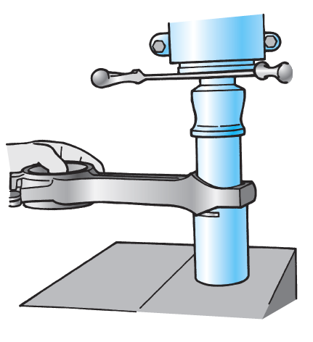
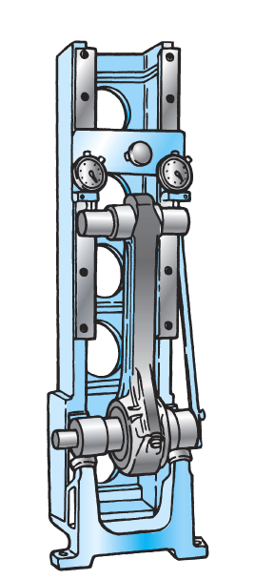
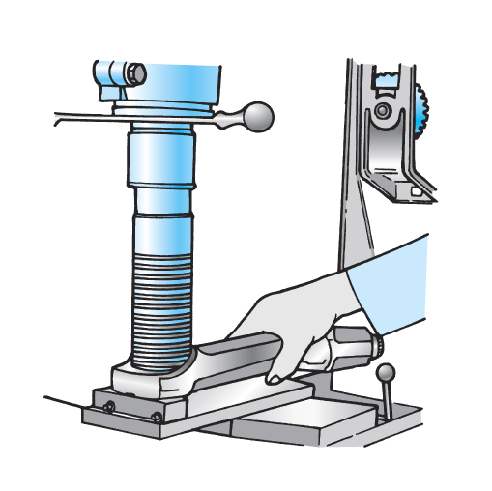
Connecting Rod Reconditioning
Preparation
  Remove piston pin bushing
  Install & retorque rod cap
Measurement
  Measure both bores
  Check for straightness
  Check for twisting
Magnaflux for cracks
Install new bushings
Check & clean oil passage
Concentricity is critical!
Always ensure that the new bushing’s
oil hole is properly aligned with the
connecting rod’s passage!
Copyright © 2009 Delmar, Cengage Learning

Slide 44
Connecting Rod Reconditioning
Failure to align the rod cap will result
in crankshaft scoring in the areas
of the web cheeks & engine seizing.
“Cracked rod” technology has reduced the need to align the connecting rod caps, although it is a good practice to check clearance after assembly. A clacking noise should be heard as the rod is shifted across the crank throw.
Best Practices
  Ensure the connecting rod isn’t “bruised” through dropping, hammering or clamping in a vice
  Before reconditioning connecting rods, check with the specific manufacturer’s recommendations
  A connecting rod set is “weight sensitive”
  Many OEMs recommend the rod cap fasteners are replaced with each reassembly
  When assembling the rod on the crankshaft check side clearance!
Marks can become stress focal
points & lead to separation failure!
Replacing or changing the weight of
a connecting rod may result in an
unbalanced engine…check your specs!
The reconditioning of connecting rods is not widely practiced on today’s diesel
engines
Copyright © 2009 Delmar, Cengage Learning

Slide 45
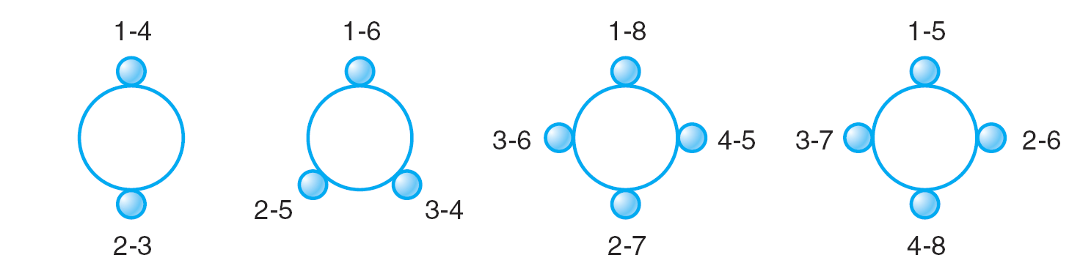
Engine Crankshafts
“V” Configured Engines
Some OEMs use unique numbering sequences:
DDC identified their V engine cylinders by bank & sequentially…
1L -1R, 2L-2R, etc.
Crankshaft
  A shaft with a series of throws
Typical throw locations (end view):
In-line 4 configuration
In-line 6 configuration
In-line 8 configuration
V-8 configuration
Copyright © 2009 Delmar, Cengage Learning

Slide 46
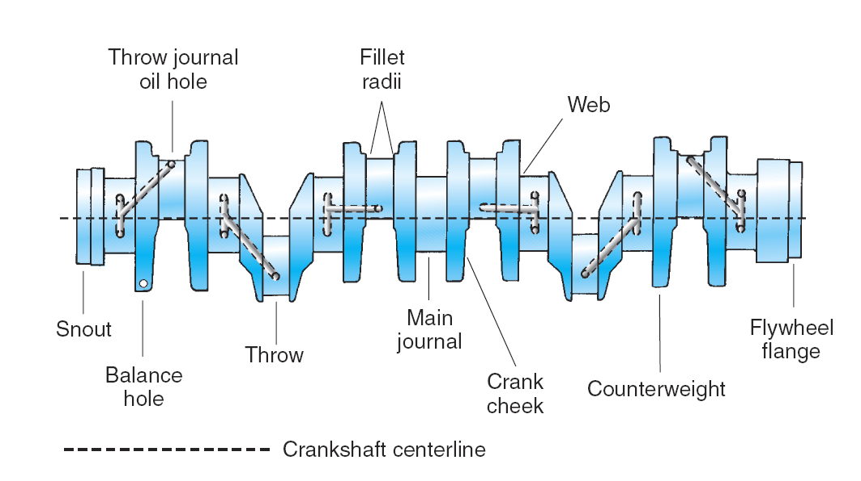
Crankshaft Terminology
Copyright © 2009 Delmar, Cengage Learning

Slide 47
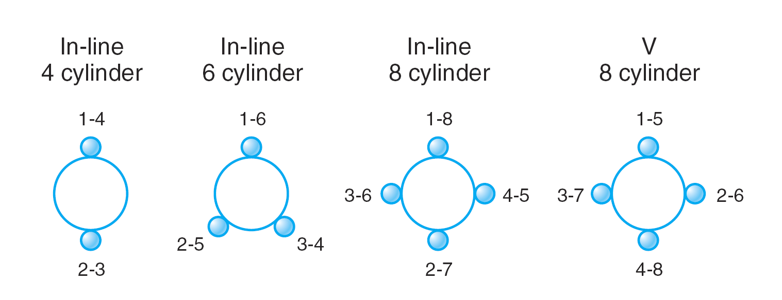
Crankshafts & Bearings
Crankshaft
  Piston assemblies are connected via connecting rods
  Converts linear piston action to rotary motion
  Supported by friction bearings
  Pressure lubrication is required to enable hydrodynamic suspension of the shaft within the bearing bores
Copyright © 2009 Delmar, Cengage Learning

Slide 48
Hydrodynamic Suspension
Rotating shaft
Pressurized lubricant
Lubricant “picked up” by shaft rotation
Wedge created
Shaft suspended
Metal-to-metal surface contact prevented
S
S
S
S
S
S
S
Crankshaft
S
S
S
S
S
Journal
Dynamic balance is maintained through the use of crankshaft counterweights
The “weights” oppose the unbalancing forces created by the pistons
Unbalance forces tend to diminish as the number of engine cylinders increase
Geometrically paired or companion throws contribute a counterbalancing effect
Dynamic balance is maintained through the use of crankshaft counterweights
The “weights” oppose the unbalancing forces created by the pistons
Copyright © 2009 Delmar, Cengage Learning

Slide 49

Crankshaft Operational Forces
Bending
  Occurs between main journals
  Created by:
    Compression
    Combustion pressures
Torsional (twisting)
  Occurs between crank throws
  Created by:
    Slowing of the crank journal on compression
    Acceleration of the crank journal on combustion
These oscillations take place at high frequencies
Crankshaft design, materials & hardening methods must take these forces into account!
Copyright © 2009 Delmar, Cengage Learning

Slide 50
Crankshaft Operational Forces
Torsional Stresses:
  Peak at crank journal oil holes – flywheel end
  Amplified at lower operational speeds & high cylinder pressures
Traditionally, this would have been referred to as “lugging” the engine
Today’s diesel engines are designed to operate:
  At 30% lower speed
  With 30% more torque
These engines produce higher torsional oscillations that are projected through the drivetrain.
Make sure the
drivetrain components
match the output of the engine
Copyright © 2009 Delmar, Cengage Learning

Slide 51
Crankshaft Construction
Materials:
  Steel forgings
  Special cast iron alloys
  All materials are tempered (heat treated)
    Designed to produce a tough flexible core
    Most OEM crankshaft manufacturing processes are proprietary
A technician’s understanding of hardening procedures is an essential consideration when addressing the reconditionability of a crankshaft!
Copyright © 2009 Delmar, Cengage Learning

Slide 52
Crankshaft Hardening Methods
Three methods used:
  Flame hardening (plain carbon & middle alloy steels)
    Direct application of heat
    Quenched with oil or water
    Produces surface hardening dependent on the carbon and alloys
  Nitriding (alloy steels)
    Higher temperatures than flame hardening
    Hardens to a greater depth (0.0225” or 0.65 mm)
  Induction hardening
    Heated by AC current through applicator coil
    Quenched with air blast or liquid
    Hardens to depths up to 0.085” or 1.75 mm
Copyright © 2009 Delmar, Cengage Learning

Slide 53
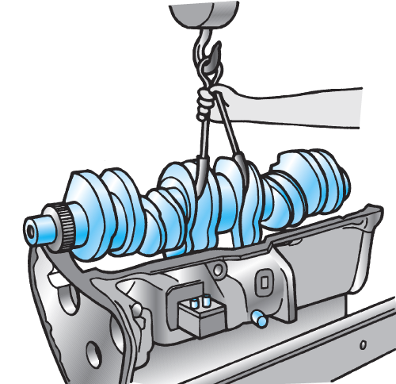
Crankshaft Removal
In a effort to reduce engine weight, OEMs use lighter alloys in the cylinder block.
To reduce block “twisting” bolster plates & buttress screws may be installed.
These must be removed to facilitate the removal of the bearing caps!
Invert engine
Remove bearing caps
Remove any other obstructions
Use crankshaft yoke
  Cover yoke with rubber hose to protect the throws
  Select two adjacent “paired” throws
Lift crankshaft from block
Copyright © 2009 Delmar, Cengage Learning

Slide 54
Crankshaft Failures
Compressors
Causes:
Lubrication related failures
    Misaligned oil hole
    Improper clearance
    Restricted passages
    Contaminated oil
  Manufacturing defects
  Bending failures
  Torsional failures
  Spun or seized bearings
  Etched bearings
Today’s R&D very thorough
Only small percentage are a result of manufacturing and design problems
Quickly remedied by OEMs
Misaligned bearing bores
  Main bearing failure or irregular wear
  Main caps broken or loose
  Wrong bearing sizes
  Flywheel housing misaligned
  Crankshaft not properly supported when out of block
Vibration damper or flywheel assembly:
  Loose
  Damaged
  Defective
Unbalanced engine drive components
Engine overspeed
Unbalanced cylinder loading
Defective engine mounts
A chemical action as a result of contaminated engine lubricant
High acidity levels can corrode all engine metals but usually first noticed on engine main bearings
May be as a result of poor maintenance practices
Appears as uneven erosion pock marks or channels
Idlers
Bending failures start
at the main journal
fillet & extend through the throw journal at 90º to the crankshaft axis
Fan
Assemblies
Excessive clearance results in lubricant throwoff, starving journals furthest from the supply
Insufficient clearance caused by:
  Overtorquing
  Undersized bearings installed where a standard specification was required
  Line bore irregularities
Fuel or coolant destroys the lubricity of engine oil!
This could lead to etched bearings
Poor maintenance practices resulting in sludge plugged passages
Torsional fractures result in
a circumferential severing
through the fillet.
In an inline 6 cylinder engine, #5 & #6 journals tend to be more vulnerable
PTOs
Pulleys
Copyright © 2009 Delmar, Cengage Learning

Slide 55
Crankshaft Inspection
Always check OEM recommendations
Usually includes:
  Measurement
  Visual inspection including Magnafluxing
Magnaflux process assists with identification of faults
  The crankshaft is magnetized and coated with iron filings
  Magnetic lines of force will “bend” into cracks causing the filings to collect
  Minute flaws can be detected with ultra-violet or black light
Always ensure a magnafluxed crankshaft has been demagnetized before reuse!
Recommended by most OEMs at every out of chassis overhaul
Copyright © 2009 Delmar, Cengage Learning

Slide 56
Crankshaft Inspection
Most small cracks observed when Magnafluxing are harmless
Beware of fillet cracks &
cracks extending into oil holes
Visual
  Cracks (Magnaflux)
    Circumferential fillet cracks
    45º cracks extending into fillet area or journal oil holes
  Wear & roughness
    Crankshaft thrust surfaces
    Front & rear main seal contact areas
Most highway diesel engine crankshafts required no special attention during the life of the engine
Minor scratches & marks may be removed by polishing the journals
Plug all oil passages
Use a crank grinding lathe & rotate in the direction of engine rotation
Wet polish with a low abrasive emery cloth
Always exercise care when working with rotating machinery!
Copyright © 2009 Delmar, Cengage Learning

Slide 57
Crankshaft Inspection
Micrometer
Measurement
  Use precision measuring instruments
  Measure at 90º intervals
  Measure at 3 linear points
Typical maximums
  Out of round: 0.025 – 0.050 mm (0.001” – 0.002”)
  Taper: 0.0375 mm (0.0015”)
Check all crankshafts for bending – refer to OEM spec’s
Out of round
Taper
Place the ends of the crankshaft in a set of “V” blocks
Using a dial indicator, rotate the crankshaft checking for deflection
Copyright © 2009 Delmar, Cengage Learning

Slide 58
Reconditioning Crankshafts
Note:
Although these processes exist, the industry consensus is that they are bad practice & represent poor long-term economics!
Most OEMs do not approve of reconditioning crankshafts!
A reconditioning process must not compromise the original surface hardening!
Reconditioning Processes:
  Grinding to undersize dimensions
  Metallizing & regrinding to specification
  Chroming surface to return to original size
  Submerged arc welding, regrinding to specification
do not approve
This process will require the installation of oversized bearings
These may not be available through the OEM
Copyright © 2009 Delmar, Cengage Learning

Slide 59
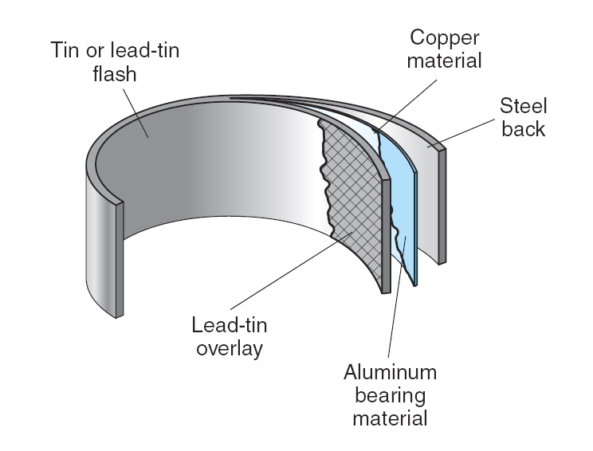
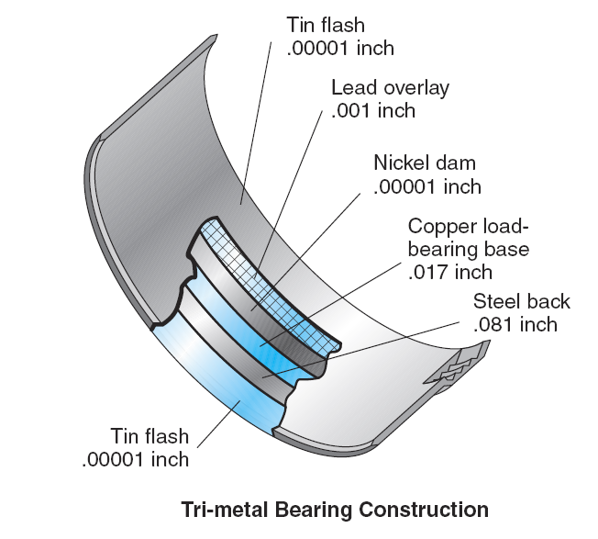
Rod & Main Bearings
Construction & Design
  Wall thickness
    Concentric
    Eccentric
Materials
  Steel base
  Copper
  Lead
  Tin
  Aluminum
Wall thickness is greater at the crown compared to the parting faces
Wall thickness is uniform
All friction bearings are designed to have a degree of embedability
The outer face must be soft enough to permit small abrasive particles to penetrate to a depth where they will cause a minimum of scoring
Copyright © 2009 Delmar, Cengage Learning

Slide 60
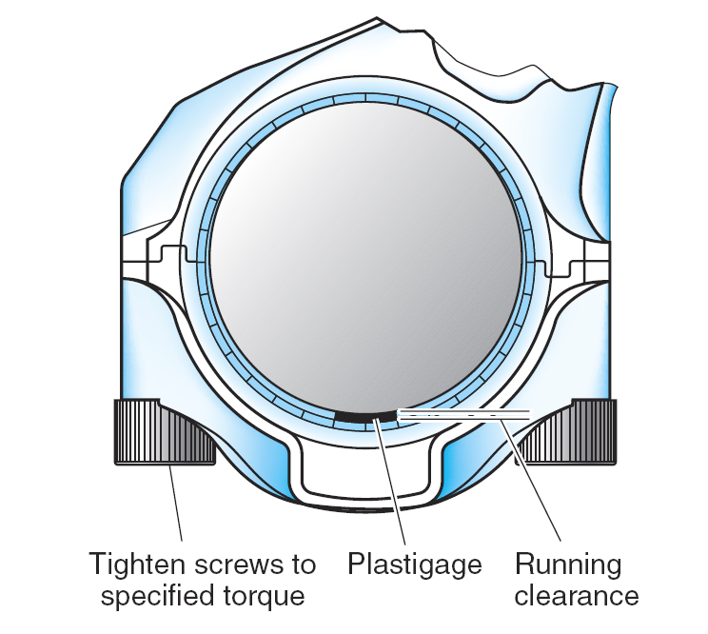
Bearing Clearance
Green Coded Plastigage
0.001 – 0.003 inch
0.025 – 0.76 mm
Red Coded Plastigage
0.002 – 0.006 inch
0.051 -0.152 mm
Blue Coded Plastigage
0.009 – 0.020 inch
0.230 – 0.510 mm
Yellow Coded Plastigage
0.102 -0.229 mm
0.004 – 0.009 inch
Note 3:
Clamp the Plastigage between the bearing and the journal
Always torque the screws to the specified torque!
Do not rotate the crank with the Plastigage in place!
Remove bearing cap
Note 4:
Compare width of Plastigage against the dimensional gauge provided on the Plastigage packaging.
Compare to engine spec’s
Remove the residual Plastigage from the journal
Note 2:
Reference the bearing clearance specifications before starting
Select the correct Plastigage to provide accurate measurement
Place a piece across the center of the bearing
Note 1:
Never attempt to measure bearing clearance while the engine is in the chassis.
Crankshaft flexibility will render the results invalid
Invert & level the engine before starting
Clearance critical to hydrodynamic suspension
Never assume a new engine has “standard” sized bearings
Clearance is precisely measured
Measurement is done with
  “Plastigage”
Plastigage is manufactured in four sizes, each color coded for the range of clearance it is capable of measuring
Plastigage is a malleable plastic thread that easily deforms & conforms to whatever clearance space is available when compressed
Copyright © 2009 Delmar, Cengage Learning

Slide 61
Crankshaft End Play
One of the main bearings is usually flanged to define crankshaft end play
These surfaces are known as “thrust bearings”
Available in several sizes to accommodate wear
Some OEMs limit crankshaft end play through the use of split rings known as “thrust washers”
Usual end play (0.2 – 0.3 mm or 0.008 -0.012”)
Use a dial indicator to measure this dimension
If thrust washers are used, place
the thicker washers to offset the
effects of the clutch!
Copyright © 2009 Delmar, Cengage Learning

Slide 62
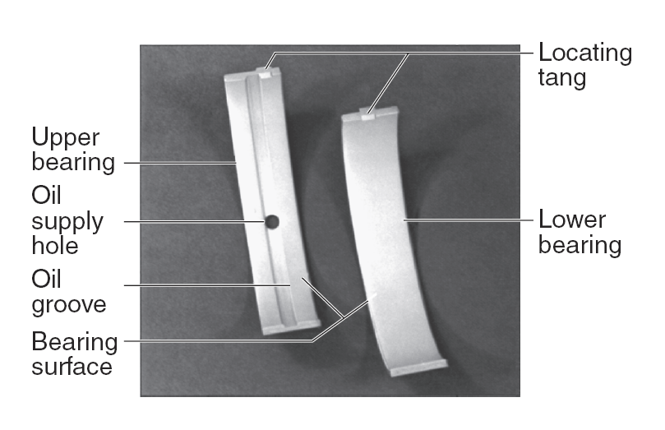
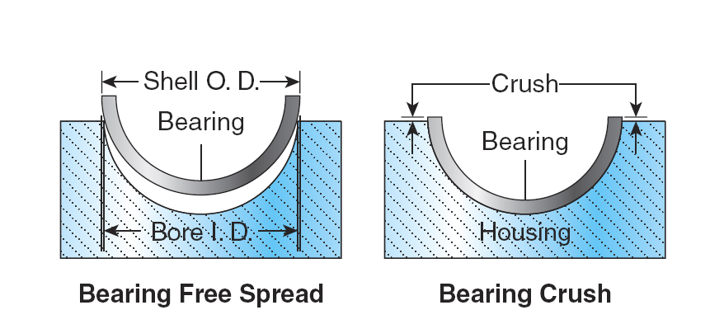
Bearing Retention
The tangs correspond to a matching groove in the bearing bore
Primarily retained by “crush”
Equipped with “tangs”, to minimize lateral travel
The bearing halves are also slightly elliptical to allow the bearing to be held in place during installation. This is known as “spread”.
The OD of the bearing shell slightly exceeds the diameter of the bore in which it is installed. This creates radial pressure.
The radial pressure acts against the bearing halves and provides good heat transfer.
Copyright © 2009 Delmar, Cengage Learning

Slide 63
Bearing Removal & Installation
Always:
Consult proper, current, service literature
Observe published procedures
Bearing “Roll ins”
  Performed while engine is in the chassis
  Handle the new bearings as little as possible
  Ensure the backing is clean and dry
  Apply a thin film of engine oil to the bearing face
  Prime the lubrication circuit before cranking the engine
Be careful, when removing the old bearings.
Do not mark or damage
the crankshaft!
Use of anything other than engine oil may result in a failure of the crankshaft to create the hydrodynamic support necessary
Do not use solvents or any other cleaning chemicals which may leave a residual film on the new bearings!
Today, this procedure is practiced more often than necessary.
It is not uncommon to remove a set of bearings in near perfect condition!
Copyright © 2009 Delmar, Cengage Learning

Slide 64

Vibration Dampers
General:
  Mounted on the free end of crankshaft (opposite flywheel end)
  Sometimes referred to as the harmonic balancer
Purpose:
  Reduce the amplitude of vibration
  Assists the flywheel’s mass establishing rotary inertia
  Reduces torsional vibration
Types:
  Solid rubber drive
  Viscous drive
Copyright © 2009 Delmar, Cengage Learning

Slide 65
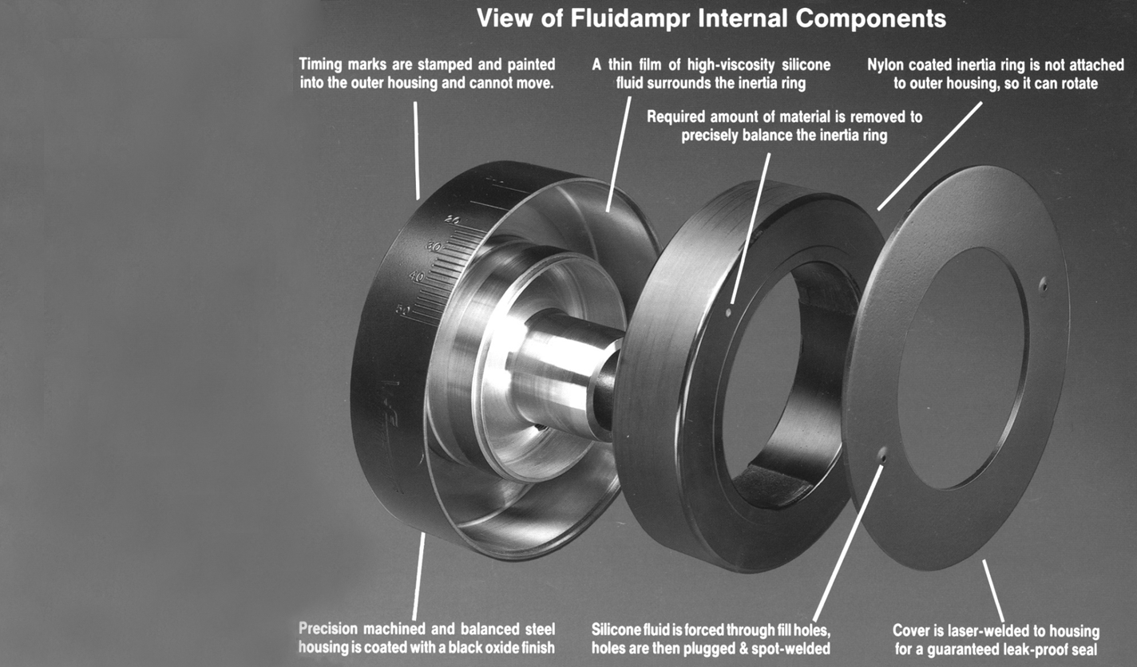
Viscous Style Construction
Replacement:
  Most OEMs recommend the replacement of the harmonic balancer at each major overhaul
  Component life often exceeds projected expectations
  Seldom replaced due to expense considerations
        Some risk involved
        May result in failed crankshaft
      ☞ Replace if there is any sign of damper housing damage or fluid leakage!
Drive Member
Hollow housing
Bolted to crankshaft
Drive Medium
Fluid (Silicone Gel)
Gel’s shearing action creates damping effect
Driven Member
Inertia ring
Suspended by fluid
Rotates at average crankshaft speed
Copyright © 2009 Delmar, Cengage Learning

Slide 66
Solid Rubber Vibration Dampers
Less often used today
  Less effective at dampening torsionals on high torque, lower speed engines
Construction:
  Drive hub bolted to crankshaft
  An outer inertia ring (contains most of the mass)
  A rubber ring, bonded to the hub and the outer ring
The elasticity of the rubber enables the unit to function as a dampening unit
Internal friction generates heat which eventually hardens the rubber rendering it less effective and vulnerable to shear failure
Copyright © 2009 Delmar, Cengage Learning

Slide 67
Vibration Damper Inspection
Visual inspection
  Dents
  Warpage
  Run out (measured with a dial gauge)
  Fluid leakage (viscous style)
Physical
  Remove from engine and shake the unit
  Heat unit – recheck for leakage
  Run unit in a lathe at engine speed – check for balance
Engine operating temperature
90º C (180º F)
Copyright © 2009 Delmar, Cengage Learning

Slide 68
Flywheels
Flywheel mass depends on:
2 cycle
4 cycle
Engine operating range
The number of crank degrees between power strokes
General
  Mounted at the rear of the engine
Function:
  Store kinetic energy in the form of inertia
    Smooth out the power pulses
    Establish an even crankshaft rotation speed
  Provide a mounting for engine output
  Provide a means to rotate the engine via a cranking motor
Energy of motion
The power take off device to which the clutch or torque converter is bolted
Copyright © 2009 Delmar, Cengage Learning

Slide 69
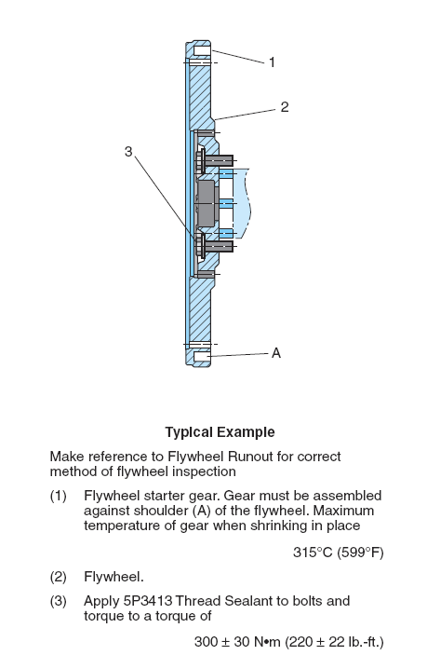
Types of Flywheels
A typical service illustration of a 15 ½” flat faced flywheel used on a Caterpillar engine
Categorized by the SAE:
  Standardization allows for:
    Different OEM Clutches
    Different OEM Transmissions
  SAE #4 = 15 ½” clutch assembly
    Usually “flat face” design
  SAE #5 = 14” clutch assembly
    Usually “pot” design
Construction:
  Cast iron
  Steel
Most flywheel stresses peak at the juncture of the rim and hub an area subject to torsional & centrifugal loads
Flywheel stress failures are rare!
Copyright © 2009 Delmar, Cengage Learning

Slide 70
Flywheel Ring Gears
Sometimes striking the cut section with a chisel is necessary to fully expand the ring gear for removal
Care must be taken to ensure the flywheel is not damaged with the torch!
Heating a Ring Gear
Only practical method is with a rose bud oxyacetylene tip
Use a temperature indicating crayon to ensure the ring gear does not become overheated
The ring gear will almost immediately contract to the flywheel
Use blacksmith tongs to handle the hot ring gear!
General:
  Shrink fitted to the periphery of the flywheel
  Transmits cranking torque to the engine from the starter
Replacement Procedures:
  Remove the flywheel from engine
  Partially cut the ring gear with an oxy-acetylene torch
    From the outside on a single tooth
    Ring gear will expand, allowing its removal
  Place flywheel on a flat surface
    Check ring gear mounting surface
    Heat the new ring gear & shrink fit it to flywheel
Ensure that the ring gear is the correct one!
If the teeth are chamfered on one side, they face the cranking motor pinion after installation
Check OEM heat value. Typically, this specification would be around 200º C although it may be as high as 315º C
Copyright © 2009 Delmar, Cengage Learning

Slide 71
Reconditioning Flywheels
Commonly removed for:
  Clutch damage
  Leaking rear main engine seals
Always inspect the flywheel for:
  Face warpage
  Heat checks
  Scoring
  Intermediate drive lug alignment & integrity (pot type)
  Axial and radial run out
Flywheels may be machined – check OEM tolerances
When resurfacing a pot type flywheel, the pot face must have as much material removed as the flywheel face!
Failure to do so will render the clutch inoperable!
Copyright © 2009 Delmar, Cengage Learning

Slide 72
Summary
The engine power train comprises of those components that deliver the power developed in the cylinders to the power take off mechanism
Aluminum trunk type pistons were widely used until the late 1980’s
    Due to their light weight & ability to transfer heat quickly
    The top ring was supported with a Ni-Resist insert
    These style of pistons were “cam ground”
    Still in use today but mostly light duty diesel engines
Two piece articulating pistons replaced the aluminum trunks style
    Favored by most OEMs until recently
Copyright © 2009 Delmar, Cengage Learning

Slide 73
Summary
Articulating pistons comprised of:
    A forged steel crown
    An aluminum alloy skirt
    Coupled together via the wrist pin
Current diesel engine OEMs favor a forged or composite steel trunk piston for their high output engines
The Mexican Hat style of crown is the most common design in today’s low emission, direct injected engines
Copyright © 2009 Delmar, Cengage Learning

Slide 74
Summary
Engine oil is used to cool the pistons
    Shaker design
    Pressure circulation
    Spray jet method
Piston rings seal the piston when cylinder pressure acts on the exposed sectional area of the ring
    The efficiency of piston ring seal increases proportionally with cylinder pressure
Gases that pass by the rings are known as “blowby gases”
Copyright © 2009 Delmar, Cengage Learning

Slide 75
Summary
The keystone ring is the most commonly used for the top compression ring
Oil control rings are designed to apply a film of lubricant on the piston upstroke & scrape the cylinder wall on the downstroke
Full floating wrist pins have bearing surfaces with both the piston boss and connecting rod eye
Crosshead pistons articulate but the semi-floating wrist pin bolts directly to the connecting rod’s small end
Copyright © 2009 Delmar, Cengage Learning

Slide 76
Summary
Full floating wrist pins are retained in the piston bosses by snap rings.
Detroit Diesel 2 stroke engines retain wrist pins via press fit caps
Connecting rods are subject to compressional and tensional loads
    Connecting rods will normally survive the life of engine but need to be thoroughly checked at each overhaul
Crankshafts are designed to withstand considerable bending & torsional stress
Copyright © 2009 Delmar, Cengage Learning

Slide 77
Summary
Most medium & large bore diesel engines use induction hardened crankshafts
Engine OEMs do not approve of reconditioning failed crankshafts
    However, the process is widespread despite the risk of subsequent failure!
Friction bearings used in crank throw & main journals are retained by “crush”
Vibration dampers consist of:
    A drive member
    Drive medium
    Inertia ring
Copyright © 2009 Delmar, Cengage Learning

Slide 78
Summary
The viscous style of damper is most commonly used on today’s truck & bus diesel engines
The shearing action of the silicone gel contained in the viscous damper effects the dampening of the engine
The flywheel stores kinetic energy in the form of inertia to help smooth power pulses delivered to the powertrain
Flywheels are categorized by size and shape
Copyright © 2009 Delmar, Cengage Learning

